Slide 1

AI and Machine Learning for IoT Big Data

Slide 2
Case study 1: WSN

Slide 3
Wireless Sensor Networks (WSN)
A short review of Wireless Sensor Networks
Anomaly detection in WSN
Security issues
Algorithmic approaches
Clustering approaches
Real-time query processing with Deep Learning

Slide 4
WSN concepts
Spatially distributed sensors (temperature etc.)
Wireless connections:
WIFI
Bluetooth, BLE (short range)
LoRa, SIGFOX (mid-range)
Streaming data, often low bandwidth
Data protocols, e.g. MQTT

Slide 5
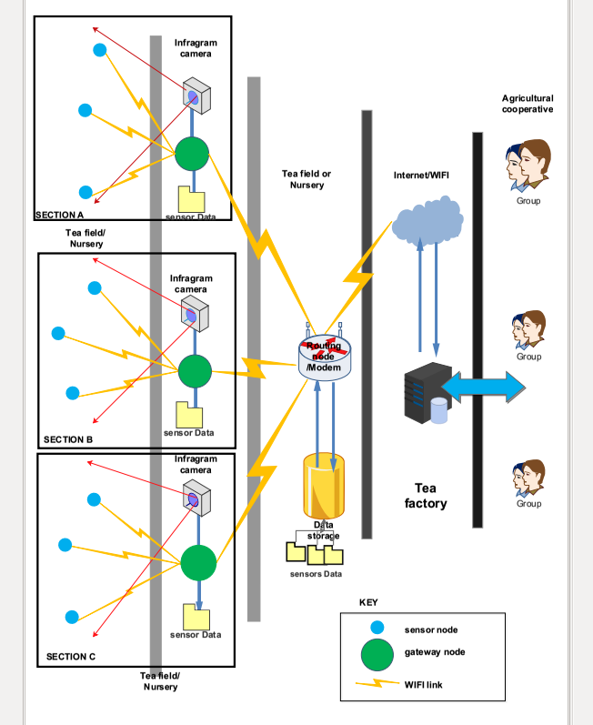
Example of a WSN: tea field monitoring in Rwanda
Environmental data collected by sensor nodes
Data routed to the Internet and aggregated in the cloud

Slide 6
A solar-powered WSN node
Credit: https://upload.wikimedia.org/wikipedia/commons/4/48/CSIRO_ScienceImage_3876_A_remote_sensing_node_part_of_CSIROs_Fleck_wireless_sensor_network_technology.jpg

Slide 7
Other common uses of WSN
Smart city: utilities (e.g. water leakage monitoring), traffic, environment etc.
Intelligent buildings
Health care (e.g. mobile monitoring)
Smart grid
Transport, tracking
Scientific sensing

Slide 8

WSN anomaly detection
A Comparative Study of Anomaly Detection Techniques for Smart City Wireless Sensor Networks
Victor Garcia-Font *, Carles Garrigues and Helena Rifà-Pous
http://www.mdpi.com/1424-8220/16/6/868
Security issues with smart city WSN
Attack detection: find anomalies
Real-world experiment is difficult
Method: detect simulated anomalies

Slide 9
Anomaly Detection Methods
Extreme values in Mahalanobis Distance
Local Outlier Factor
Hierarchical Clustering
Classification with Support Vector Machines One-class Support Vector Machines (OC-SVM): Semi-supervised learning with Radial Basis Function (RBF) kernel

Slide 10
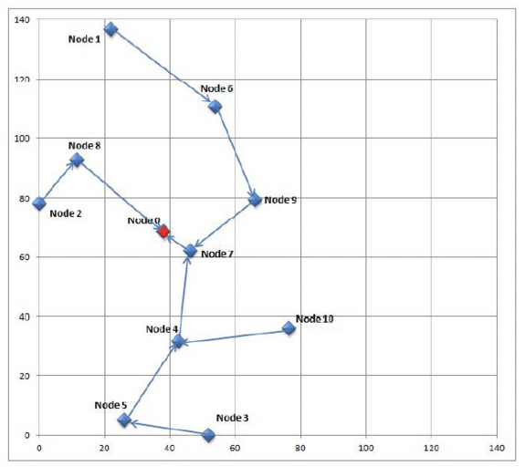
Simulated Smart City WSN
Sound streams collected at 10 locations are reproduced in simulation

Slide 11
Feature Selection
Feature Vector 1 (FV1) : number of application packets, hour of the day
Feature Vector 2 (FV2) : FV1 fields, sequence number, battery level, lost packets, consumed energy
Feature Vector 3 (FV3) : FV2 fields, WSN link quality, received MAC ACK and CTS

Slide 12
Flow of analysis
The anomaly analysis comprises three basic sub-steps for each of the compared techniques: the training, the validation and the test phases.
…The filtered dataset … divided … in Figure. …The attack samples are not included in the training dataset (a), because the detection techniques … are semi-supervised or unsupervised.
… The validation and test datasets … divided into 8 additional datasets ((b) to (i) in the figure), resulting in a total of 17 datasets (16 + 1 training dataset).

Slide 13
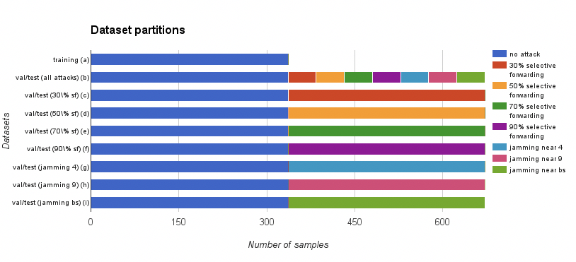
Simulated datasets for training the

Slide 14
Training phase
…Normalize and standardize the features in all the datasets (i.e., subtracting the mean and dividing by the standard deviation for each feature), … identify the features that have a zero variance in the training dataset, … removed from the three datasets (i.e., training, validation and test)
… Three different levels of false positive rate: permissive (false positive rate < 15%), restrictive (false positive rate < 10%) and very restrictive (false positive rate < 5%).

Slide 15
Validation and test phase
The validation and test datasets are used to evaluate the performance of the algorithms in 72 experiments: (1 with all the attacks together + 7 with each attack separately) x 3 feature vector definitions x 3 PFPR levels.
..Use the detection algorithms to decide whether each sample has to be considered as an attack or not, …
count the correct identifications of attacks as true positives, the incorrect identifications of attacks as false positives, the correct identifications of no attacks as true negatives and the incorrect identifications of no attacks as false negatives.

Slide 16
Results sorted by True Positive Rate (TPR)
OC-SVM dominates

Slide 17
Discussion
Compare the TPR for the four methods
What is the reason for requiring low FPR? What happens with many false positives?
Consider other anomaly situations; how to weight TPR vs. FPR? When would we allow many false alarms in return for finding all attacks?

